Slide 1
Hydraulic Fracturing Data Analysis by Husein Ali

Slide 2
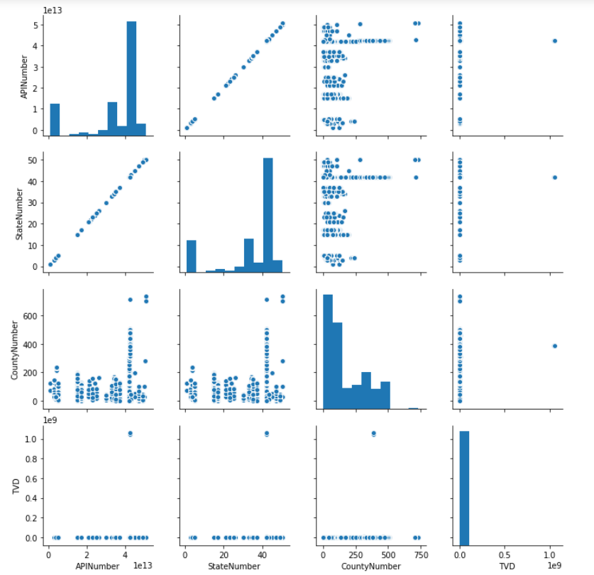
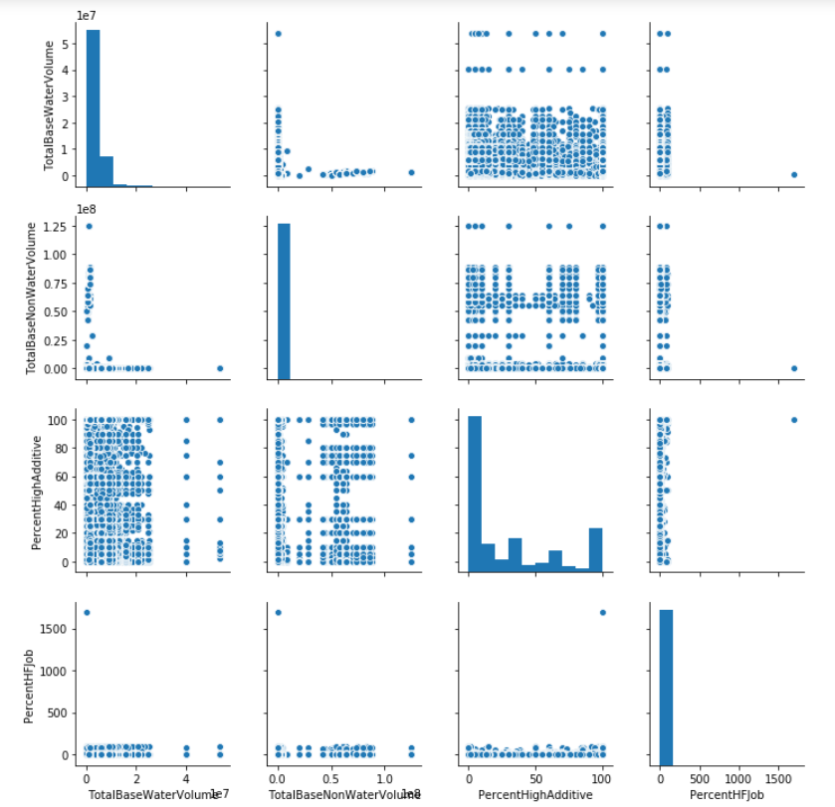
Project analysis slide 2
Correlation between variables using Pairplot
Relationship between different Variables for Registry 1

Slide 3
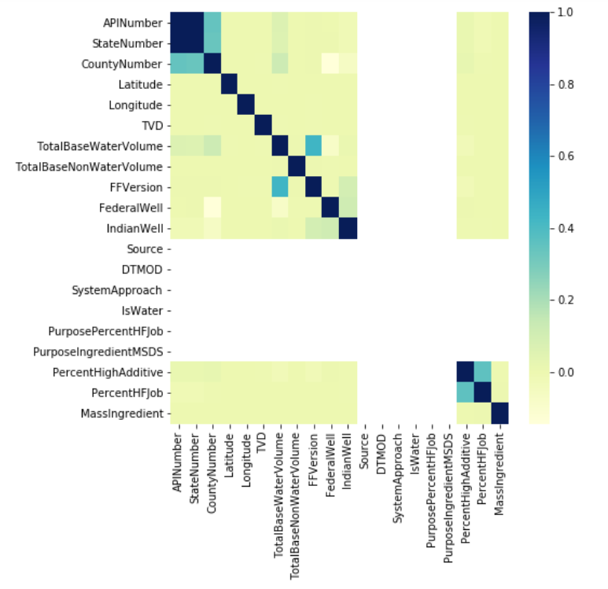
Project analysis slide 2
Correlation between variables using Heatmap
Relationship between different Variables using Heatmap

Slide 4
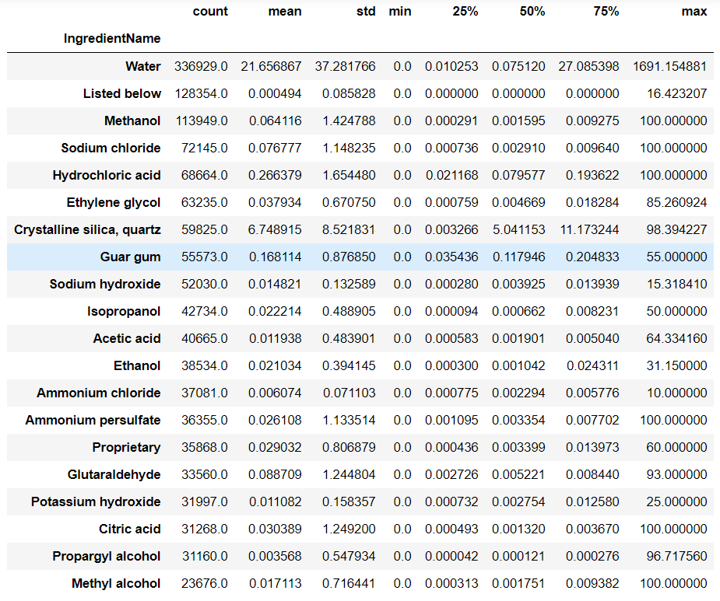
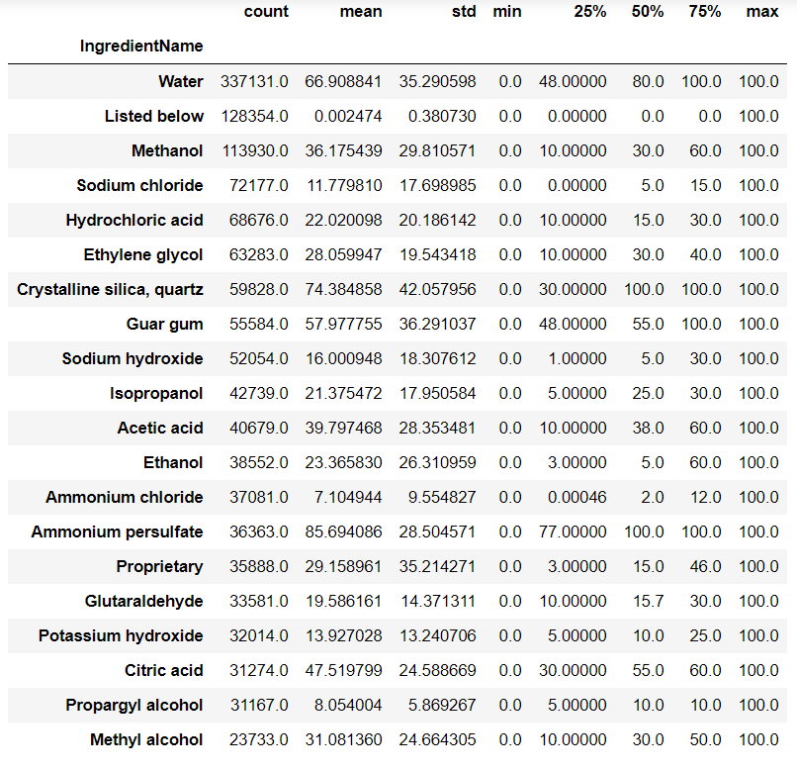
Project analysis slide 2
Ingredients and their Percent HFJob and HighAdditive
Top 20 Ingredients and their PercentHFJob
Top 20 Ingredients and their PercentHighAdditive

Slide 5
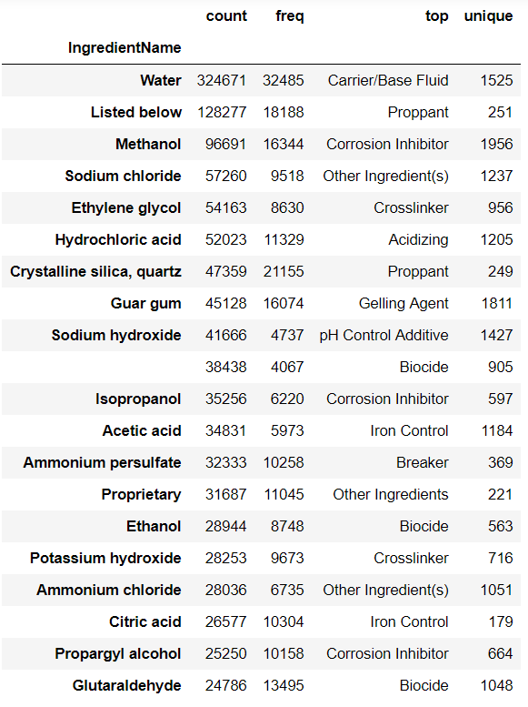
Project analysis slide 2
Ingredients and their Purpose
Ingredients and their top listed purposes

Slide 6
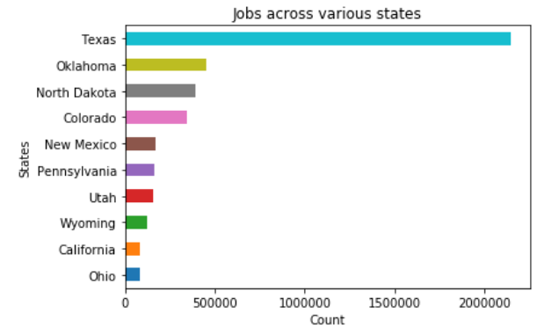
Project analysis slide 2
State-wise HF Jobs using barplot
State-wise Hydraulic Fracturing Jobs over the entire dataset

Slide 7
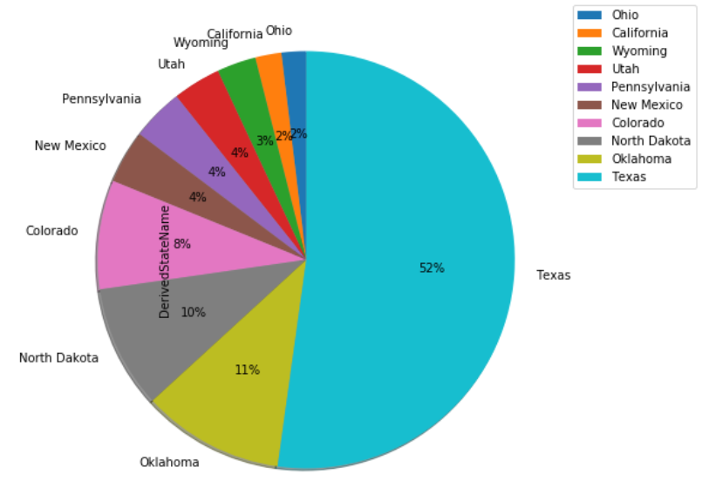
Project analysis slide 2
State-wise HF Jobs using piechart
Percentage distribution of State-wise Hydraulic Fracturing Jobs over the entire dataset

Slide 8
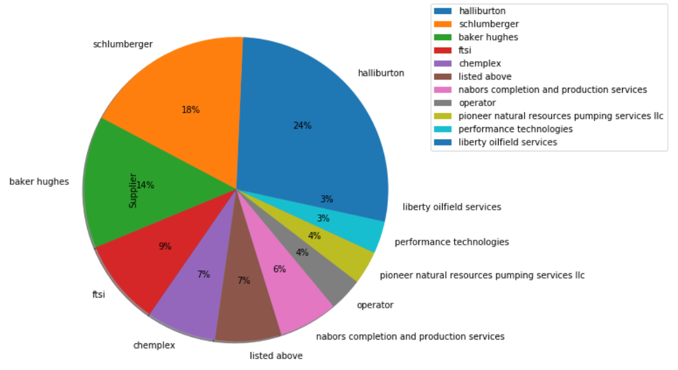
Project analysis slide 2
Suppliers contracted
Percentage wise distribution of different suppliers that supplied the product for hydraulic fracturing job

Slide 9
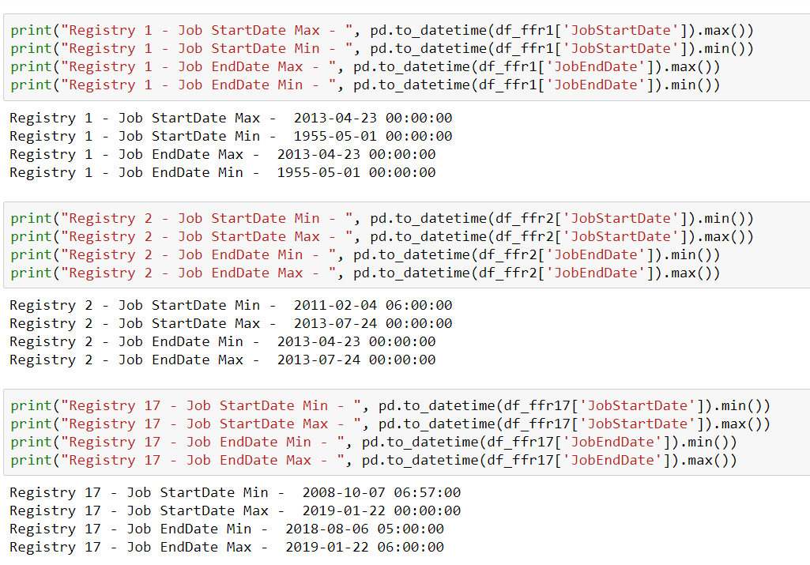
Project analysis slide 2
Time Analysis
Maximum and minimum Start and End times of jobs across Registries 1, 2, and 17

Slide 10
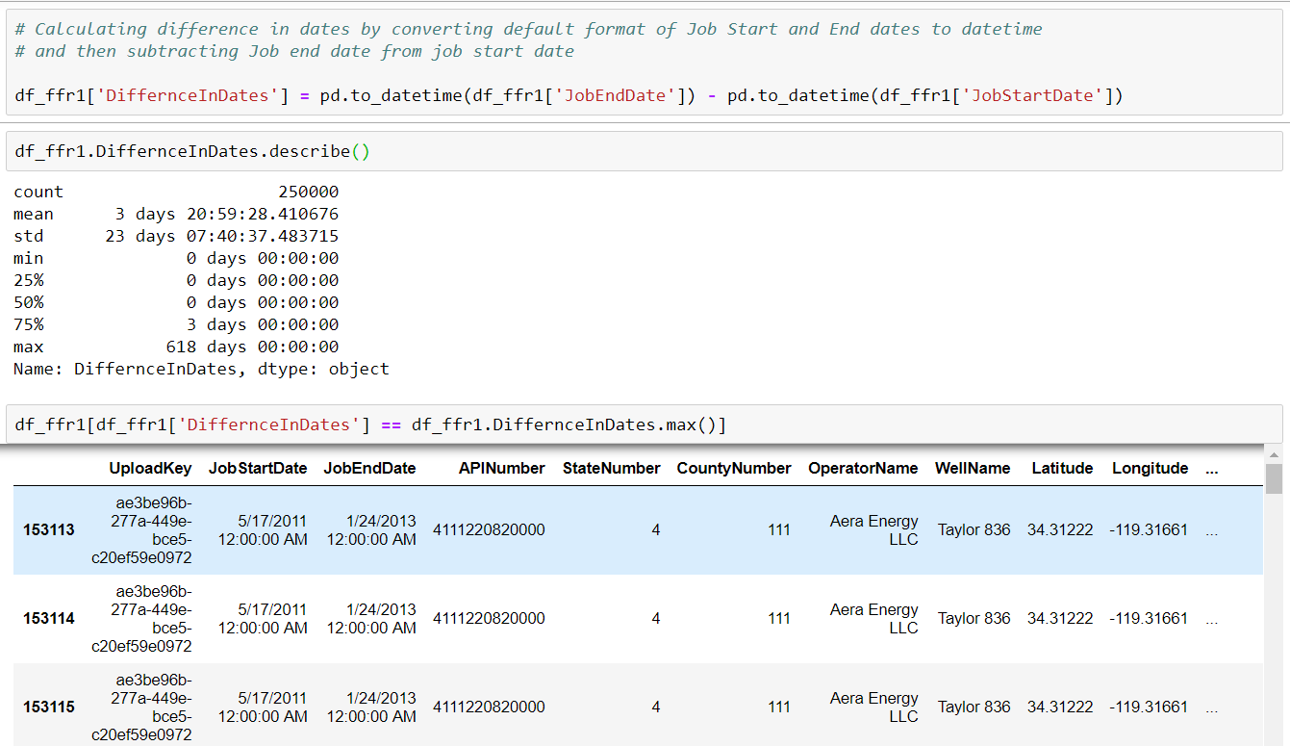
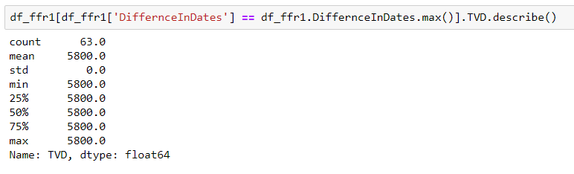
Project analysis slide 2
Time Analysis
Difference in days of jobs for Registry 1 and analysis of longest job in that period

Slide 11
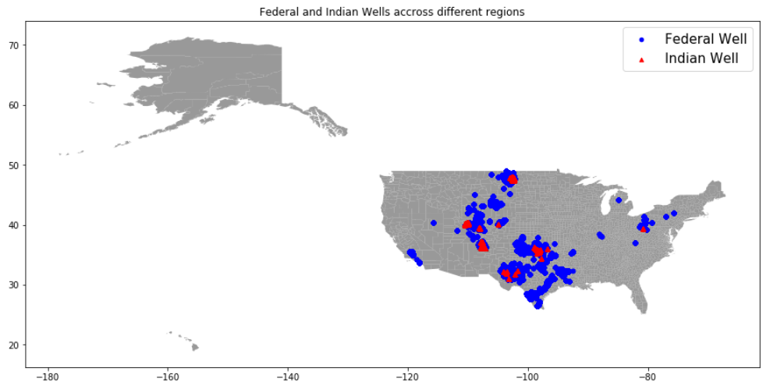
Project analysis slide 2
Federal and Indian Wells
Federal and Indian Wells that were operated for Hydraulic Fracturing

Slide 12
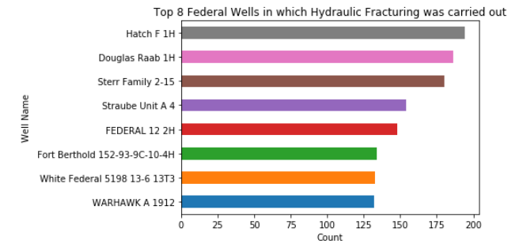
Project analysis slide 2
Federal Wells
Most Frequently operated Federal Wells

Slide 13
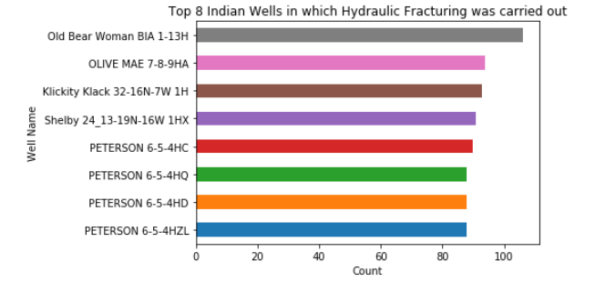
Project analysis slide 2
Indian Wells
Most Frequently operated Indian Wells

Slide 14
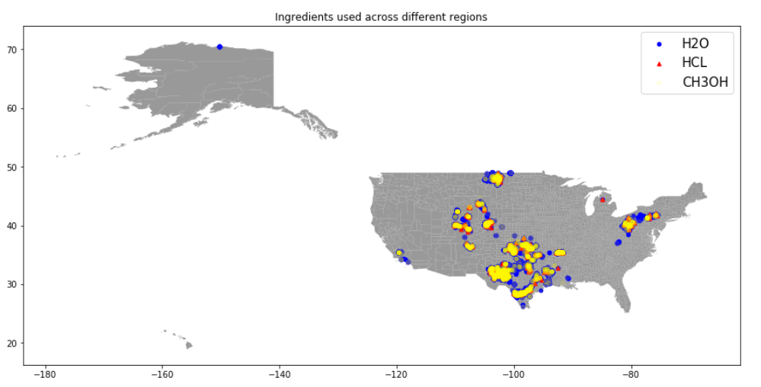
Project analysis slide 2
FracFocus Data Analysis
Different Ingredients used across various regions for Registry 1

Slide 15
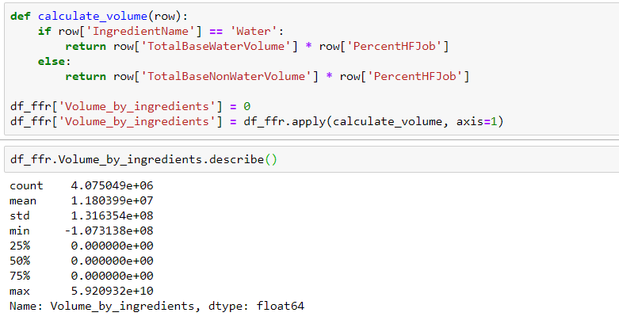
Project analysis slide 2
Calculation of Volume based on Ingredients
Further analysis that could be carried out

Slide 16
Thank You

